Slide 1
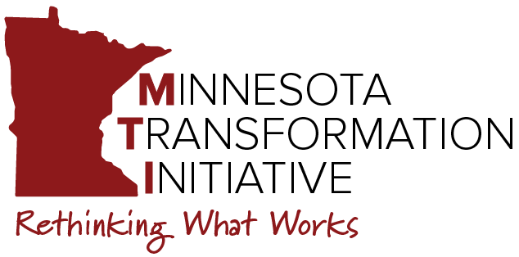
MTI Community of Practice
Transformation: Finances and Allocation of Resources
January 24, 2024
Notes:
Brian

Slide 2
Agenda
Quick look-ahead to final CoPs:
  February: Keeping the Momentum of Transformation
  March: TCW grant wrap-up and Celebration of Successes
Today: Transformation and Resource Allocation
  Short presentation with some considerations
  Group discussion
3. Closing Announcements & Reminders
Notes:
Brian

Slide 3
Building Caseloads
Billable time is one factor that should determine caseloads
For staff delivering employment services, how much of their time must be billable?
Key Factors – the services they are providing
  Pre-Employment Transition Services (youth ages 14 - 22)
  Vocational Rehabilitation Services (adults)
  Waiver employment services (EES, EDS, ESS)
Notes:
Brian
Question for the group: How do you ensure job coaches have a caseload that is financially sustainable?
Determining your staff’s billable time is key to building their caseload. A general rule of thumb is 80% billable time, or 32 hours a week for your FTE.
Billable time is impacted by the services provided. The reimbursement rates for VR and Pre-ETS is different from Waiver employment services. The paperwork requirements are different as well.
One differences between VR, Pre-ETS, and Waiver employment services are: you can bill “on-behalf of” time under waiver services, you cannot for most Pre-ETS and VR services

Slide 4
Building Caseloads
Waiver employment services have different rates
If a staff is providing Employment Support Services, they may have a bigger caseload
If a staff only helps people find jobs, they may have a smaller caseload
Notes:
Brian
Employment Exploration and Employment Development – Plan have higher rates than Employment Support. EES and EDS-Plan are $15.75, ESS is $14.25
Staff may have a bigger caseload if they are just providing Employment Support Services, meaning they are helping people keep their job
Staff that help people find jobs may have a smaller caseload because this work is more time intensive

Slide 5
Customized Employment
  Customized Employment (CE) and the Discovery Process is a specific service paid for by Voc Rehab
  CE is an interest-based negotiation between the job seeker and employer (DEED)
  CE is a proven evidence-based practice that improves employment outcomes for youth and adults with disabilities (NDI)
  Sources:
  MN DEED. Customized Employment
  National Disability Institute. Discovery & Customized Employment
Notes:
Brian

Slide 6
Customized Employment training
  CE can only be delivered by individuals that have gone through the training and been certified
  CE training is a great way to invest in your staff
  This training is delivered by Voc Rehab and is free
  CE training cohorts start April 30 and September 3
Notes:
Brian
Customized Employment and the Discovery Process can only be delivered by staff that have gone through the training and have been certified
We are not suggesting you send all of your staff through this training, but it is a great way to invest in your staff
This training is delivered by Voc Rehab and is being offered free of charge this year as part of the state’s investment and commitment to competitive integrated employment for people with disabilities
The training is delivered in a cohort model with 60 participants.
The training last 16 weeks with class every other Tuesday for a half-day
Throughout the training participants get paired with a person that wants the service. This means the participant is learning the material then immediately applying it in the real world.
Contact Margie Webb if you’ve got staff that you’d like to send to the training. Margie’s contact information is included on the resources slide

Slide 7
Other Resources
  What is E1MN?
  Sign up for E1MN communications from DEED
  Organization mentorship
Notes:
Brian
Question for the group: What is E1MN? E1MN is Minnesota’s state agency partnership to advance Employment First outcomes for youth and adults with disabilities. The state agency partnership evolved from Minnesota’s Employment First policy adopted by the Olmstead sub-cabinet in 2014.
The E1MN Newsletter is a monthly e-communication sent out by MN DEED. It is a way to communicate important information to professionals who support employment outcomes for youth and adults with disabilities.
As grantees you have access to organization mentors. The MTI team is here to help, but you may also find it helpful to talk with people managers with other organizations that are providing employment services to get insight into how they structure their caseloads connect staff with trainings to strengthen employment outcomes

Slide 8
10 Essential Elements of Provider Transformation
Leadership, Focus & Values
Clear and consistent goals
Agency culture supports inclusion
Employment Practices & Community Life Engagement
Customer focus & engagement
A holistic approach
Active person-centered job development
Infrastructure, Operations & Finance
Reallocated, restructured resources
Strong communication plan
Ongoing staff development
Performance measurement & QA
Diverse community partnerships
ThinkWork Agency Change Toolkit
Notes:
Staci
Brian gave some considerations and examples of allocation of resources related to employment caseloads and how you are structuring those….but I want to take this conversation back up to the 10,000 ft strategic view. And, it's been a while since we've looked this slide, but let’s look at it in the context of what Brian just talked about and where it may fit in when we look at the 10 essential elements of provider transformation. And from my perspective, some of what Brian talked about certainly fits in with leadership, it definitely falls under employment practices and an active person-centered job development. But the big one where we want to draw some attention is under the bucket of infrastructure, operations and finance…we have the element that speaks to reallocated and restructured resources. and while we all agree that leadership and values associated with the outcomes you'd like to see are also critical, just having vision isn't enough. It's also essential to ensure that HOW you use are using your resources is actually aligning with the goals you have identified. If you continue to use most of your existing resources in the same way, while only dedicating a few resources to your new service delivery, the changes most likely won’t be as sustainable or effective than looking more widely…

Slide 9
Organizational Transformation
State policy and legislation
Best Practices
Federal policy and legislation
Values
History
Strategic alignment of mission, vision, operations and outcomes.
Notes:
Staci
This is just another way to visualize transformation. On the left you see a number of different external factors (like history, federal and state policy and legislation changes…things like employment first and phase outs of subminimum wage for example, national focus on best practices, evolving values over the last few decades.....) all of those things and more may have impacted your organization's decision to start a transformation process and ultimately, transformation means that there has been a strategic alignment of your mission, your vision, your operations and outcomes. If your operations, or HOW you engage in business every day isn't changing, then it's unlikely that you'll see different outcomes on the scale you'd like to see them. And so, that’s why it is so important that the organization takes time to review existing resources and HOW they are being used.

Slide 10
What are your organization's resources?
Financial
Human (paid staff & volunteers)
Physical
Intellectual
Partnerships
Data & info
Marketing
Culture
Others?
Notes:
Staci
So, what ARE your organization’s resources? It's important when doing any kind of assessment of your organization's resources that you again look holistically across the entire organization and not just focusing only on funding or financial resources. Financial resources are critical, but also identify a list of ALL resources you have available…for example: the entirety of your human resources (that includes both paid staff and any volunteers you have, including board of directors and others)...and it also means looking at all the ways you are USING those human resources. Other resources include physical or capital...those could include things the organization owns; like buildings and vehicles. Your organization also has intellectual capital as well. That just means all the combined knowledge and skills all of those human resources you have access to hold. Part of that assessment might mean making sure you have the right people, with the right knowledge and skills in the right positions. DO you know what talents your workforce and volunteers have that you haven’t tapped into? You'll want to assess what kinds of partnerships you are engaged in and do any of them need to be updated based on your new business focus or model. We've talked a lot over the last year and a half about the importance of data and information you track and review. You may not automatically think about this data as a resource, but… These pieces of data provide opportunities for you to make more informed decisions, and to set and track goals…and depending on how you share out this data, it could help your organization to be more transparent or accountable to your internal and external stakeholders. How you market what you do is also a resource, and we've seen a few of you actively updating your outreach materials or create videos that highlight your employment services differently..... and one of the biggest resources that maybe doesn't get talked about enough is the culture of the organization. And a testament of it's importance is that you could potentially have all the other resources aligned, but without culture being aligned with your resources, things may not move in the right direction. So, allll this to say that as a leadership team it's worth regularly assessing all your resources and checking in with whether they are all appriately aligned with the outcomes you want to see. And at this point in the grant project, I believe most of you have done some variation of this exercise, but certainly as we get closer to this grant ending, focus on sustainability in your operations, particularly for those pilots that some of you startd…to ensure that you can continue doing the things you want to continue doing….

Slide 11
Reallocating Staff Resources at Company ABC
Updated Services
20 Day staff
9 Employment staff
Legacy Services
25 Day staff
4 Employment staff
In this example:
Each time 5 new people get jobs, another Day position
is reallocated to Employment
Notes:
Staci
This example has been significantly simplified in order to illustrate HOW you can think about reallocating resources. In this example... I'm focused on staffing resources, but you can use the example to think about any of the resources on the previous page. On the left you can see the staffing breakdown for the historic, legacy model of support at Company ABC. In this organization we support about 85 people in non-work day services and about 10 people in employment services. And that means we have 25 staff dedicated to center based day services and 4 dedicated to competitive integrated employment. Our company's goal is to get 30 people competitive integrated jobs, so we'll have to figure out how to get more staff focused on employment. Some of the staffing might come from new hires, that the organization is able to budget in from the revenue that's already being generated, but most likely this company won't be able to hire a large quantity of new staff at one time. So this means taking a look at they can best use the existing resources they have in place. And this company has decided that as a certain number of people get competitive integrated jobs and leave the center, that means they will commit to using one of those center-based staff positions in a different way. One way to do this is to reallocate that position from one that supports day services to one that supports employment. So instead of having 25 day positions and 4 employment positions, after 5 people get jobs, you may be able to shift 1 day position to an employment position. If your organization has regular staff turnover, one way to do this is that when a staff vacates a day position through turnover, it doesn’t get re-filled and gets advertised instead as an employment position. Another way to do this is to provide training, mentoring and support to your some key EXISTING day staff to so that they are ready to consider a shift to a new position, as they become available. Typically, employment positions may pay a higher wage, so for some this may be an incentive....and having these discussions ahead of time with staff that you think have some transferable skills or who have a lot of cultural influence is a great place to start. There is no one size fits all approach to reallocation of staff resources, but it is important to create a plan and then implement and track the plan over time. The other thing I’ll mention about this example is that along with identifying how you might use resources differently, might mean that you need to STOP doing other things that no longer lead you to the outcomes you stated. So, if CIE is your goal but most of your staff are dedicated to group or center based employment, it means looking at whether some realignment could happen there.

Slide 12

Let’s hear from you...
Are there ways you could be using existing resources differently in order to increase competitive integrated employment and/or community integration? ​
Do you have existing legacy staff that can be used differently? How?
Notes:
Staci

Slide 13

Last 2 Scheduled CoPs
February 28
March 27
Next Quarterly Training
February 15 1-2:30pm CT
Engaging Employers for Competitive Integrated Employment
Dominique Berg & Denise Johnson
Register: https://mti.ici.umn.edu/trainings

Slide 14
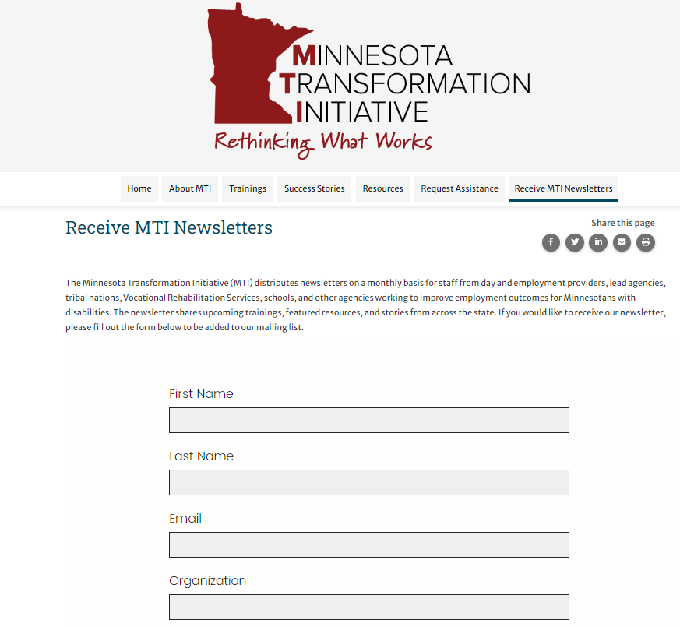
Sign up for MTI's Newsletter
https://mti.ici.umn.edu/mti-newsletter
Notes:
Staci

Slide 15
Resources
  E1MN e-communications. https://public.govdelivery.com/accounts/MNDEED/subscriber/new?topic_id=MNDEED_1111
  Margie Webb MS, CRC – Customized Employment Specialist, DEED. Email - Margie.webb@state.mn.us
  MN DEED. Customized Employment. https://mn.gov/deed/job-seekers/disabilities/partners/guide/contracted-services/services/customized/
  National Disability Institute. Discovery & Customized Employment. https://www.nationaldisabilityinstitute.org/employment/discovery-and-customized-employment/#:~:text=Discovery%20is%20the%20foundation%20of,who%20experience%20barriers%20to%20employment.

